Slide 1
﷽

Slide 2
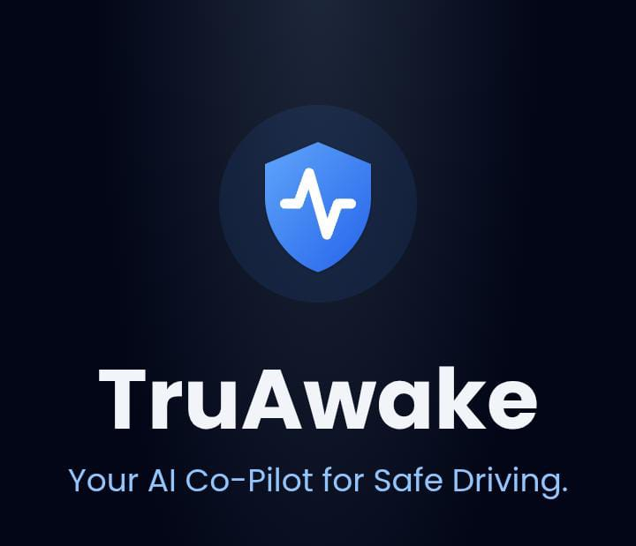
Tru Awake
Driver drowsiness detection Using AI to Enhance Road Safety

Slide 3
Supervised By: Muhammad Umar
Group Members:
Aneesha Khan (FSD-SP-062) Rabia Rafia (FSD-SP-084)

Slide 4
Agenda
Introduction
Problem Domain
Proposed Solution(Truwake)
System Modules
Use Case Model
Application Architecture
Achievements

Slide 5
introduction
TruAwake is an AI-powered driver safety application designed to prevent road accidents caused by drowsiness and fatigue. It detects signs of driver fatigue by using the smartphone’s front camera and built-in sensors, such as facial movements, eye closure, yawning, and head tilt.
The application provides real-time alerts through alarms and notifications to immediately warn the driver and help prevent accidents.
TruAwake does not require any expensive hardware, wearable devices, or vehicle-installed systems.
It runs entirely on a smartphone, making it non-intrusive, affordable, privacy-focused, and easily accessible for all drivers.

Slide 6
Problem Domain
Pakistan experiences a high number of motorway and highway accidents, with driver drowsiness and fatigue being a major cause. Although several drowsiness detection systems exist, they depend on expensive hardware, wearable devices such as EEG/EMG sensors, or advanced vehicle-integrated technologies found in cars like Tesla and Volvo, making them impractical for common drivers. Therefore, there is a clear need for an affordable, accessible, and mobile-based solution that can effectively detect driver drowsiness without requiring specialized equipment.

Slide 7
Proposed Solution(TruAwake)
TruAwake detects driver drowsiness by analyzing eye closure, yawning, head tilt, facial and body movements, along with data collected from mobile sensors such as the accelerometer and gyroscope. When drowsiness is detected, the application immediately triggers real-time alerts, including a loud alarm, vibration alerts, and an emergency contact option to ensure timely intervention and enhance driver safety.

Slide 8
System Modules
TruAwake consists of software and hardware modules. The software modules include User Authentication, Alarm Module, Analytics and Reports, Theme and UI Customization, Notifications and Reminders, and a Search Feature. The hardware requirements are minimal, requiring only an Android smartphone with at least 2GB RAM, 300MB storage, and a mobile holder for stable usage during driving.

Slide 9
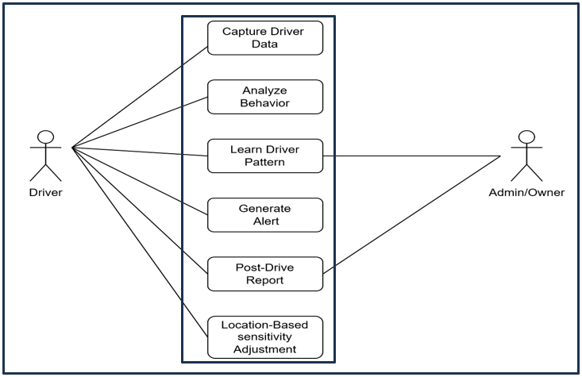
Use Case Model

Slide 10
Application Architecture
TruAwake follows a mobile-based, on-device architecture that ensures privacy and real-time performance. The system processes a real-time camera feed and combines it with sensor data fusion from mobile sensors. A Google API–based AI model is used for facial and eye landmark detection. The application is built with a React Native frontend and JavaScript backend modules, while data is stored using local storage with optional Supabase cloud support for reports and user data.

Slide 11
Achievements
Complete AI-based driver monitoring system
Real-time image processing for drowsiness detection
Instant alert generation with emergency escalation
Analytics and visual driving reports
Backend camera functionality continues while app is switched
Dark and light theme customization
Optimized frontend and backend architecture for performance and stability

Slide 12
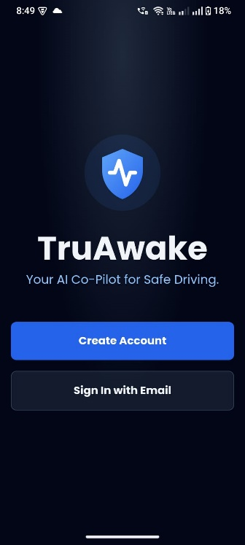
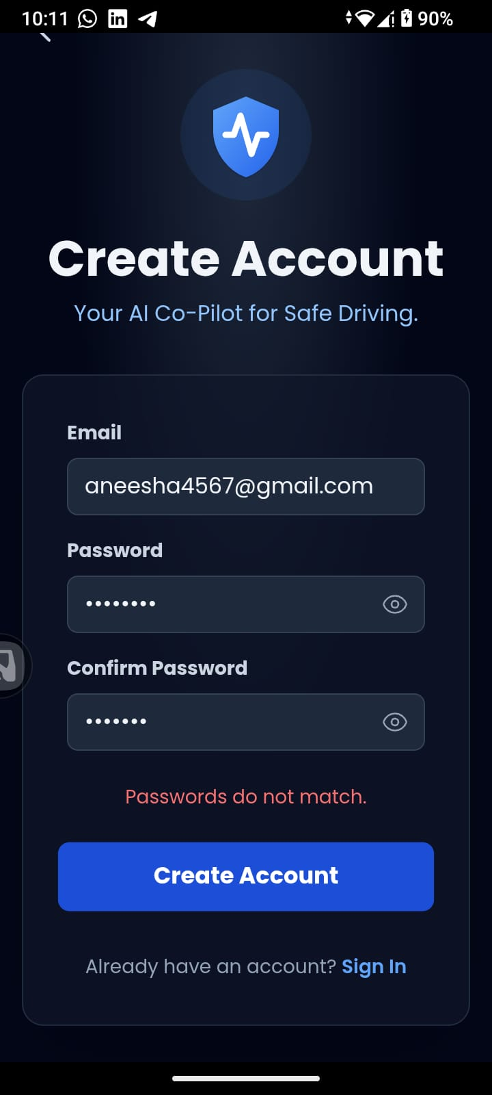
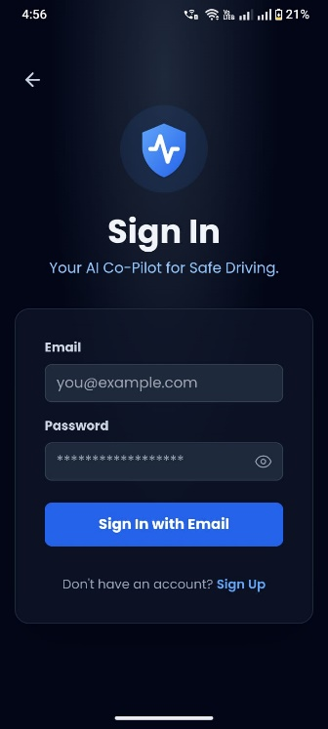
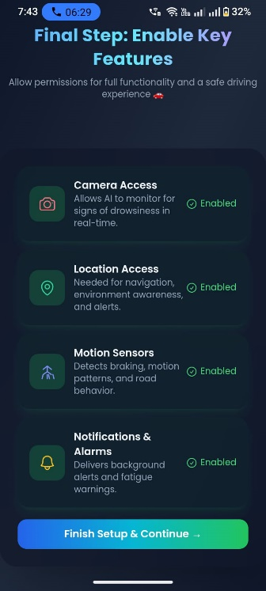
Login/Authentication Screen

Slide 13
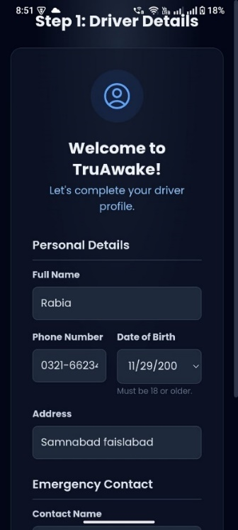
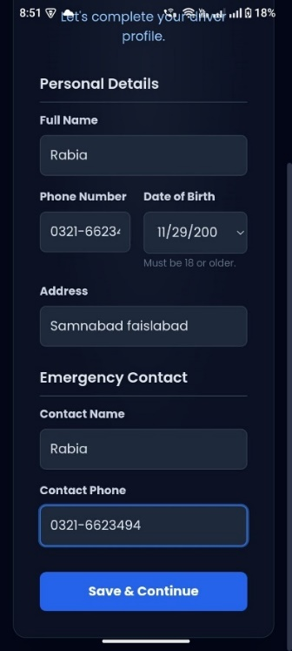
User Registration

Slide 14
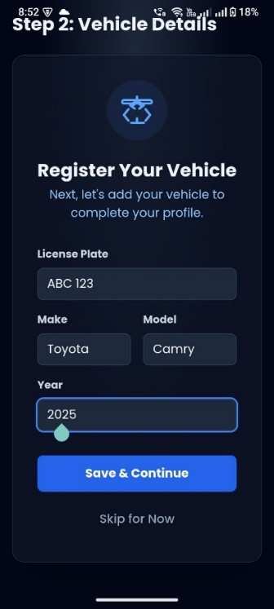
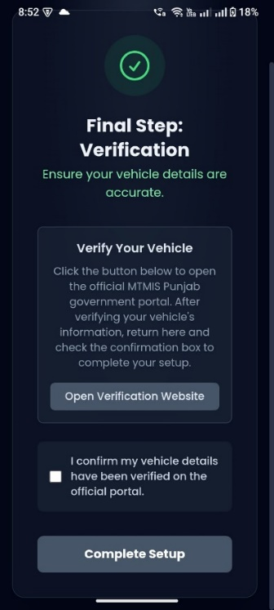
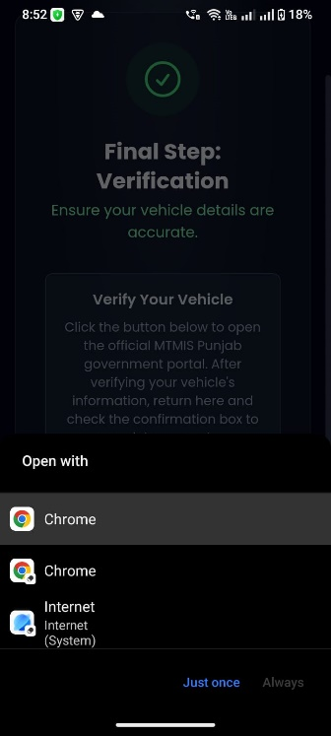
Vehicle Registration

Slide 15
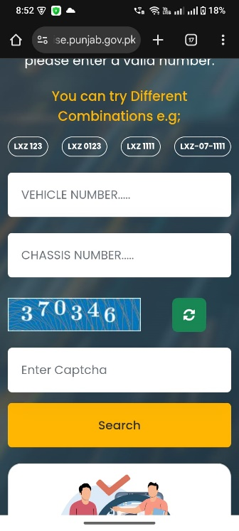
Verify License

Slide 16
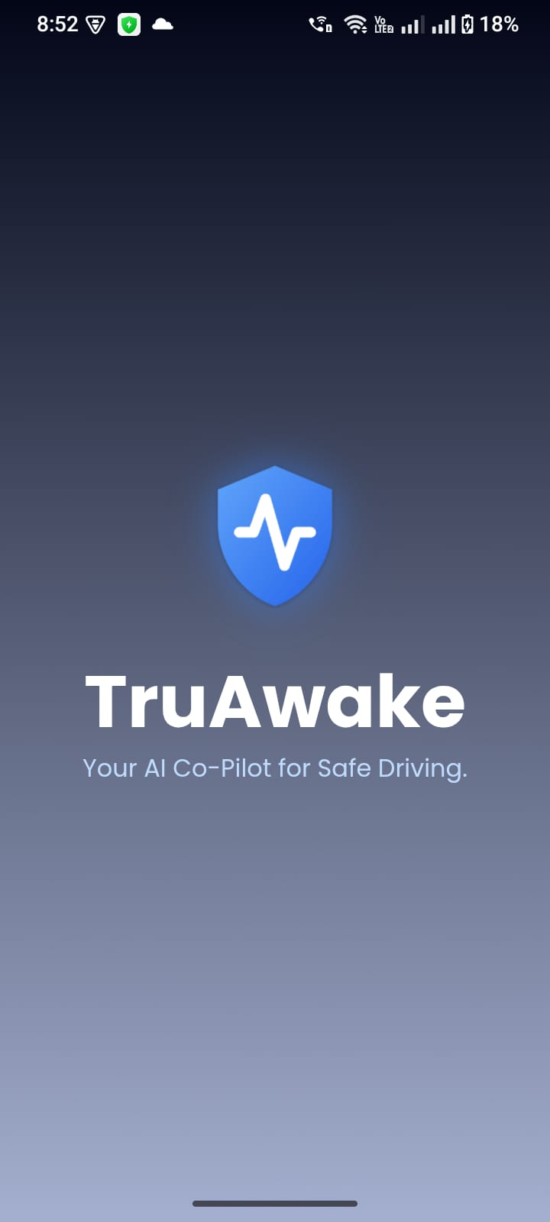
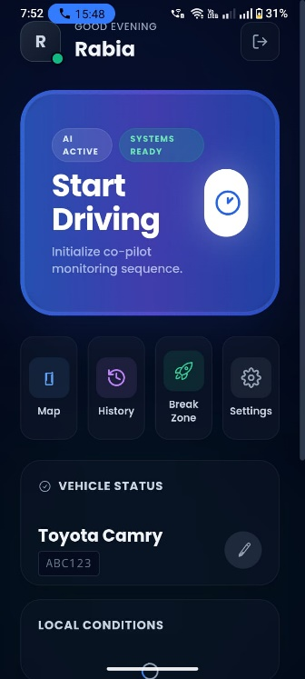
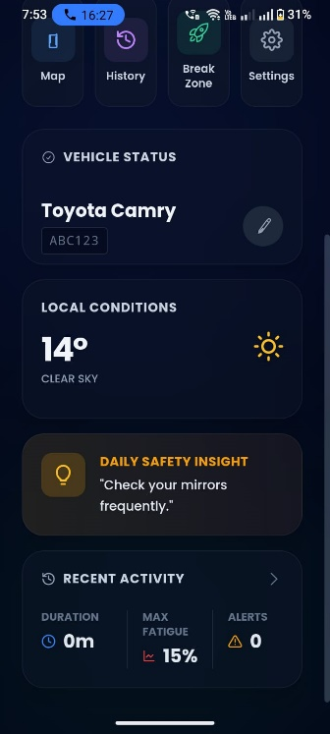
User Dashboard

Slide 17
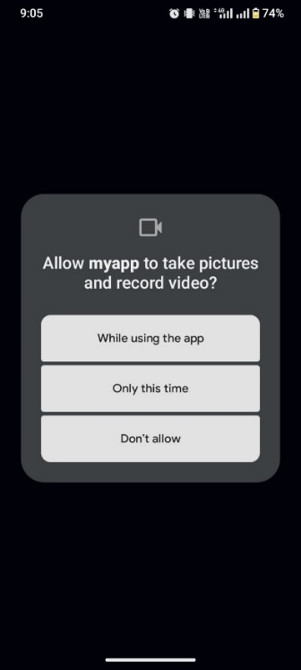
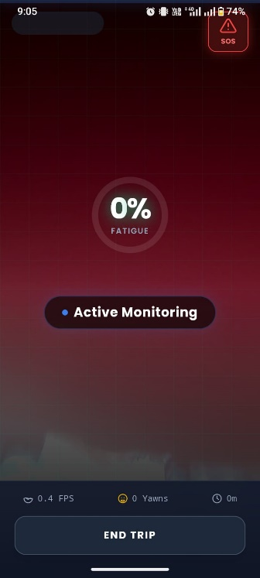
Real-Time Monitoring screen

Slide 18
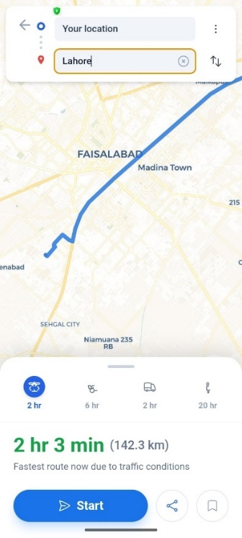
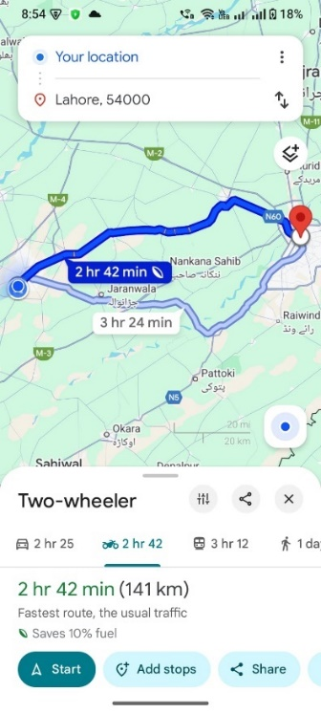
Location Awareness Module

Slide 19
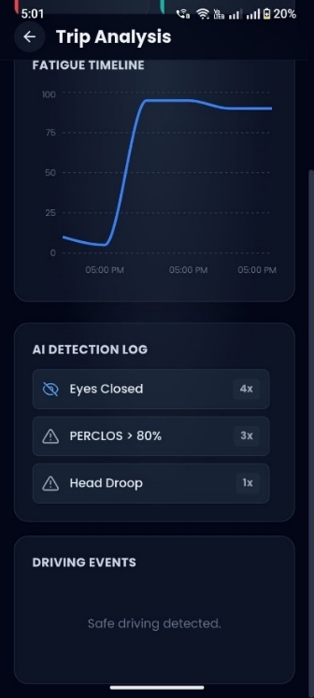
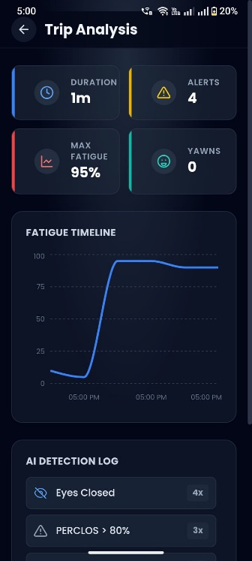
Post-Drive Report

Slide 20
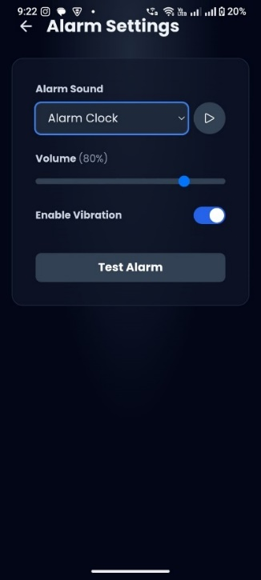
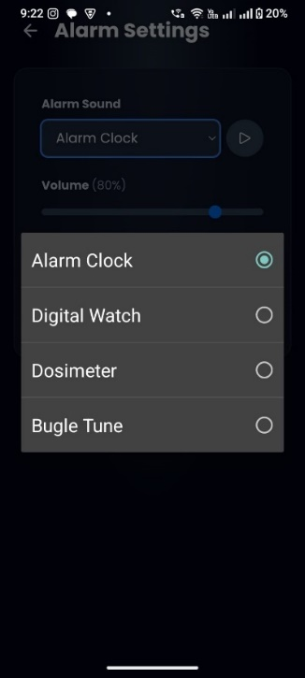
Alert

Slide 21
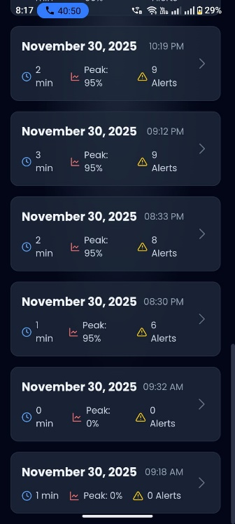
Statistical Data

Slide 22
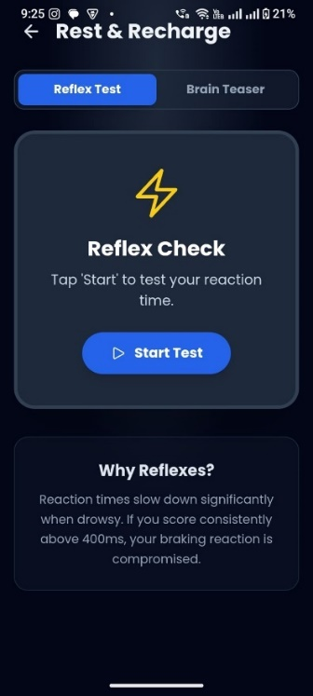
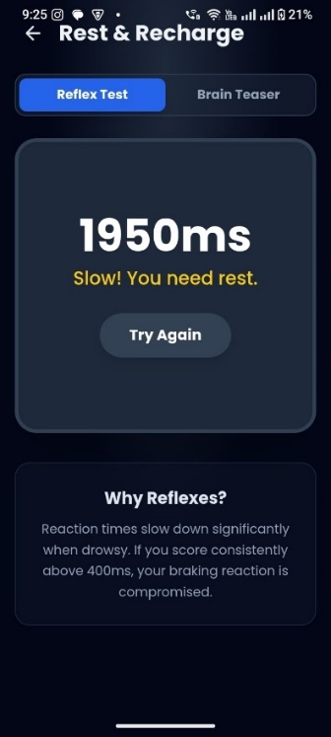
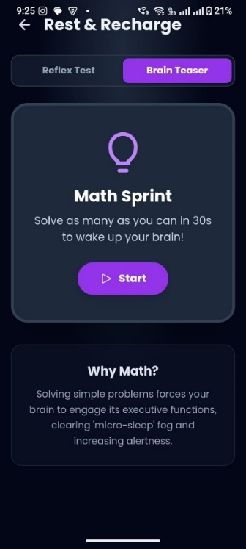
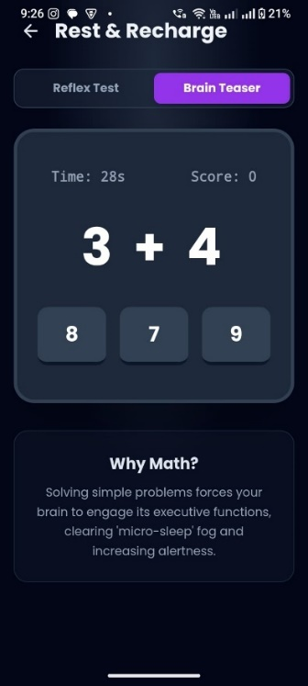
Activities

Slide 23
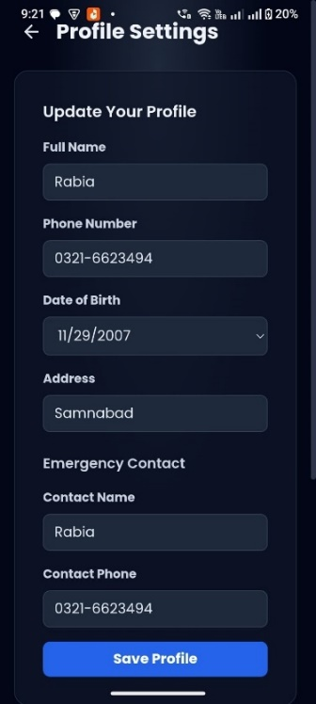
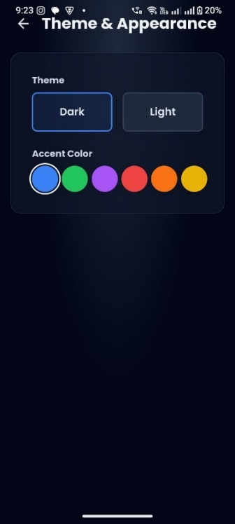
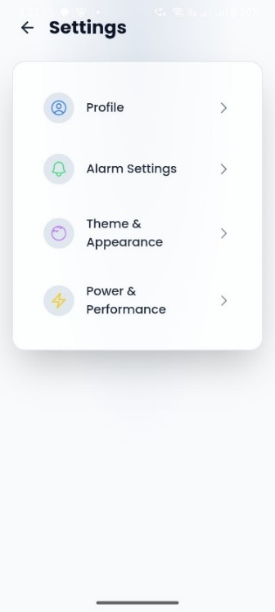
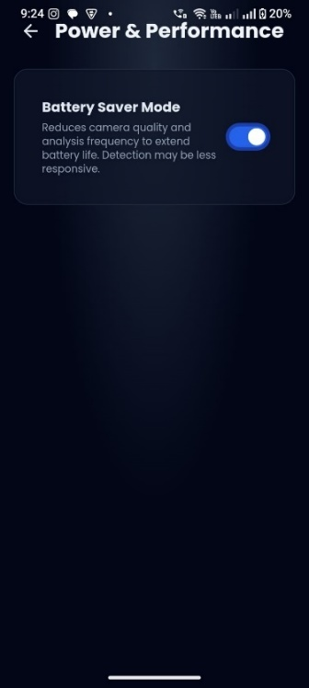
Settings & Customization

Slide 24
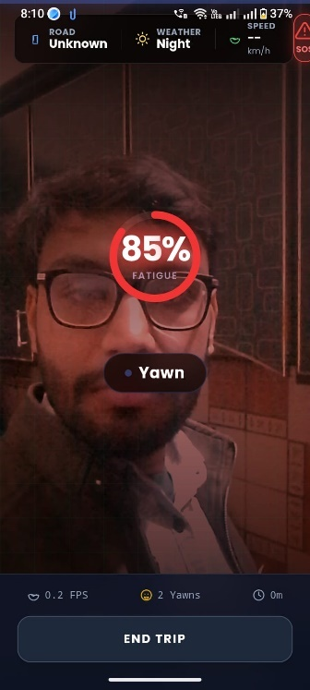
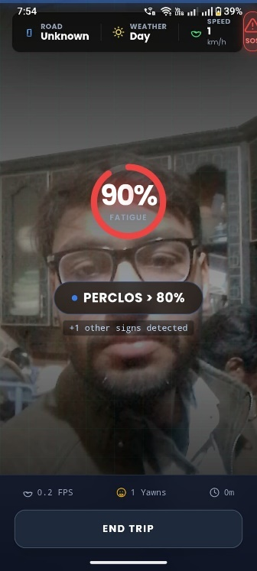
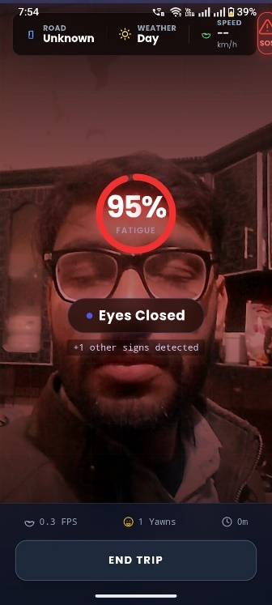
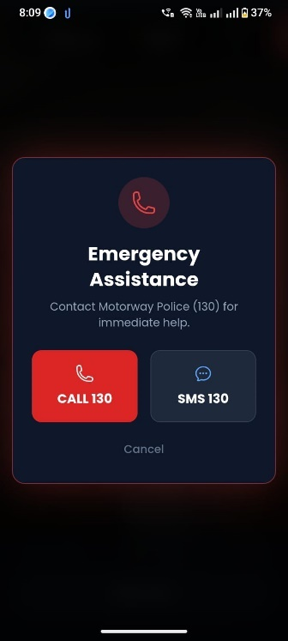
Testing

Slide 25
Thank You

